Slide 1

Community Engagement through Technology
Town of Marana
Team Gartner-002

Slide 2




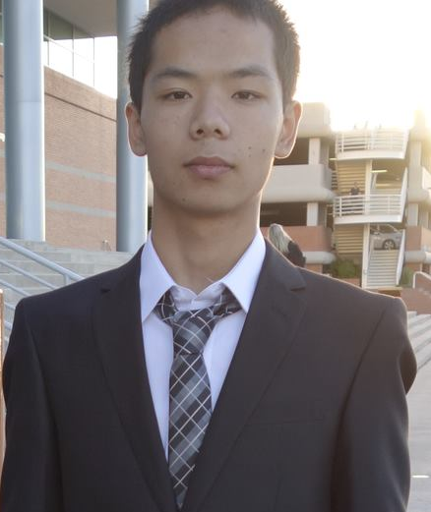
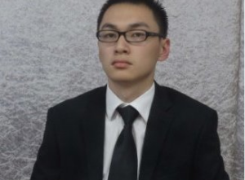
The Team
Abhinav Sharma
Renuka Unhale
Sarah Luciano
Mingda Wang
Qiandong Lin

Slide 3
Agenda
Current Situation
Objective
Envision Solution
Our Solution
Technology
Budget
Timeline
Next Steps

Slide 4

Current Situation
Marana’s goal is “To maintain a safe and well planned community”
The community has to be more involved and engaged
Town has experienced a number of cultural shifts and societal changes
Situation Objective Envisioning Solution Solution Advantages Technology Budget/Timeline Summary

Slide 5
Objective
Increase community engagement focusing on age group 18-30
Focus on the integration of technology
Expand the use of Marana’s website and mobile app
Identify creative options to market the website and mobile app
Situation Objective Envisioning Solution Solution Advantages Technology Budget/Timeline Summary
Notes:
Increase community engagement focusing on age group 18-30
Focus on the integration of technology
Expand the use of Marana’s website and mobile app
Identify creative options to market the website and mobile app

Slide 6
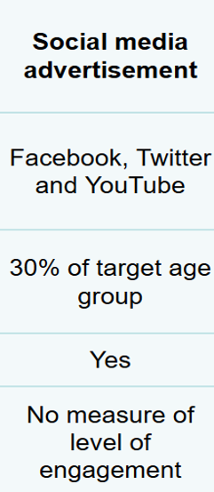
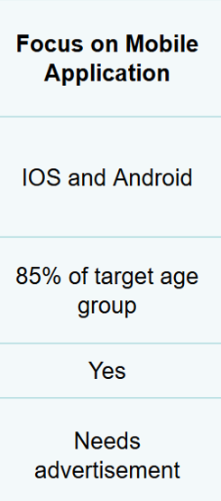
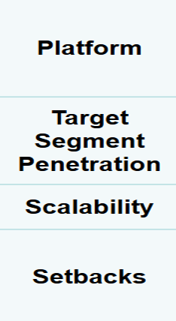
Envisioning Solution
Situation Objective Envisioning Solution Solution Advantages Technology Budget/Timeline Summary

Slide 7

Our Solution
Citizen Participation and Rewarding Program
Situation Objective Envisioning Solution Solution Advantages Technology Budget/Timeline Summary

Slide 8

Overview
Citizens are able to track their community service
Users will be notified about opportunities of involvement
Users collect badges as a result of participation
Users can be rewarded based on their badges
- Town of Marana acknowledgment
- Letter from the Mayor
- Citizen of the year Award
Situation Objective Envisioning Solution Solution Advantages Technology Budget/Timeline Summary

Slide 9
Demo
Citizen Participation and Rewarding Program
Goal – “Provide the user with incentives, to ensure their participation”
Source : https://starpass.residentportal.com/resident_portal/?module=home
Situation Objective Envisioning Solution Solution Advantages Technology Budget/Timeline Summary
Notes:
What is badge
Timeframe
1/2 badge description

Slide 10
Advantages: Citizen
Maintain a history of community service
Be aware, in a more personalized way, about what its happening in the community
Gain community recognition
Strengthens community coherence and understanding
Situation Objective Envisioning Solution Solution Advantages Technology Budget/Timeline Summary

Slide 11
Advantages: Town of Marana
Identify the leaders in your community
Maintain your community active in an innovative way
Incorporate new data to the analysis of community engagement
Attract a younger population
Situation Objective Envisioning Solution Solution Advantages Technology Budget/Timeline Summary
Notes:
Identify the leaders in your community
An innovative way to maintain your community active
Enhances one’s motivation for participation
New data to incorporate in the analysis of community engagement
Young population is most likely to use this program

Slide 12
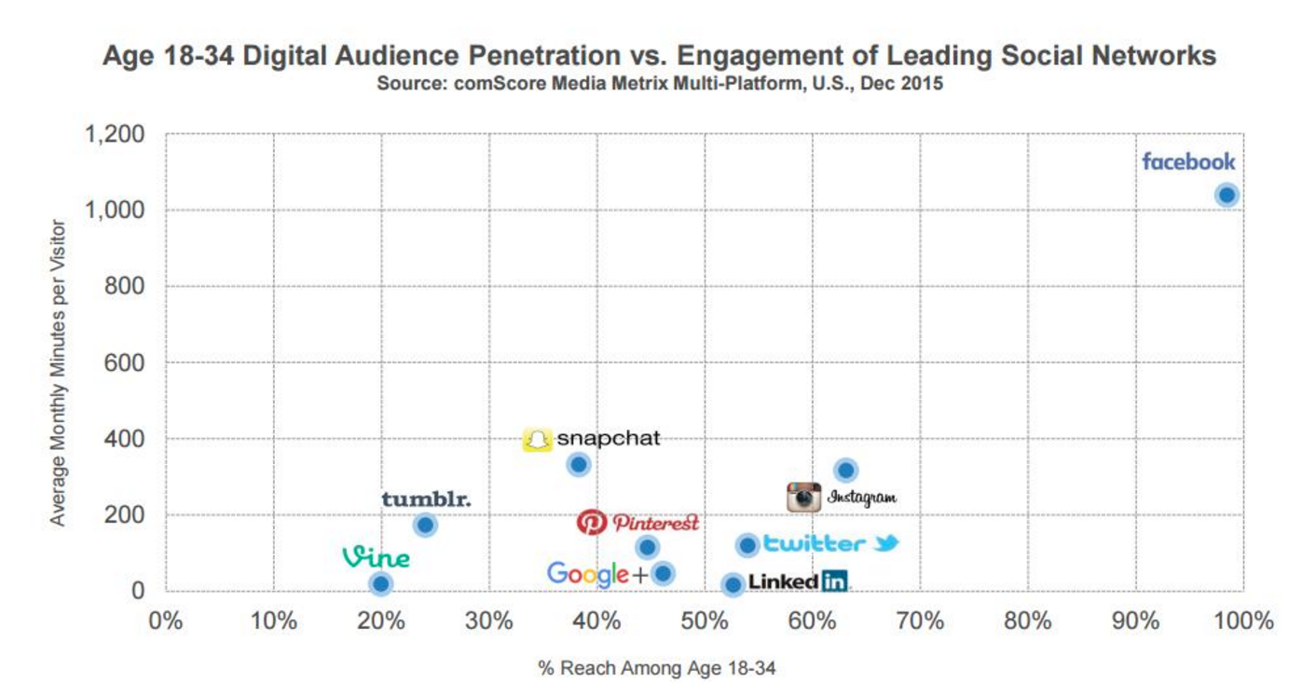
Marketing Analysis
Facebook is the best option
Situation Objective Envisioning Solution Solution Advantages Technology Budget/Timeline Summary

Slide 13
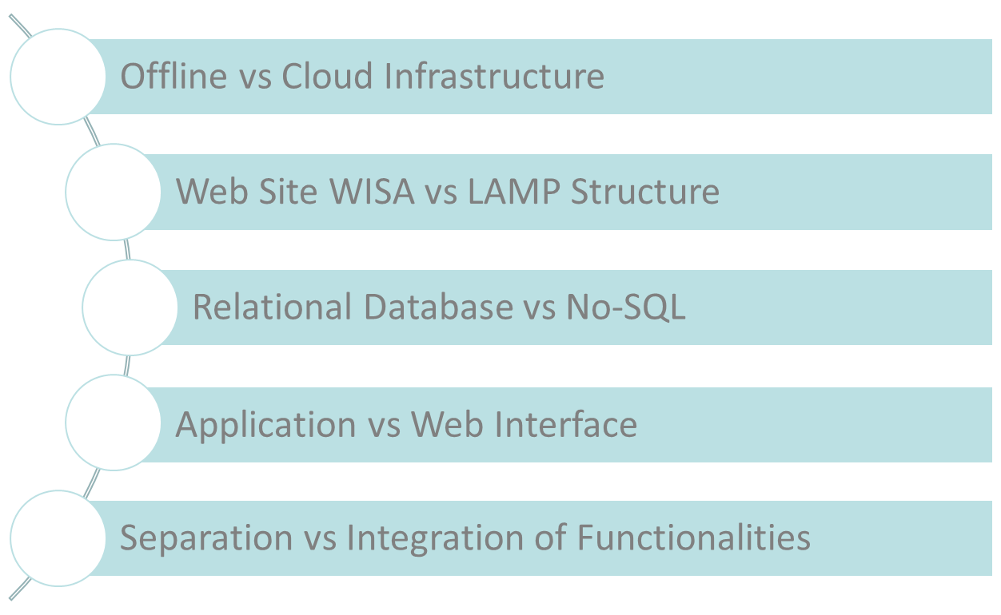
Technology
Situation Objective Envisioning Solution Solution Advantages Technology Budget/Timeline Summary

Slide 14
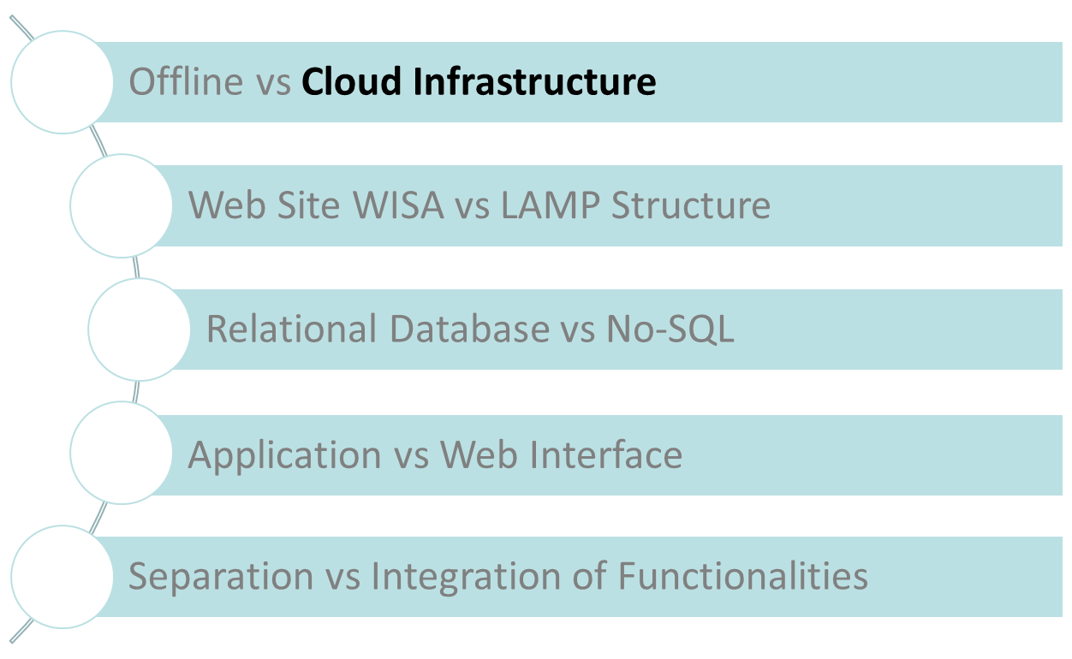
Technology
Situation Objective Envisioning Solution Solution Advantages Technology Budget/Timeline Summary

Slide 15
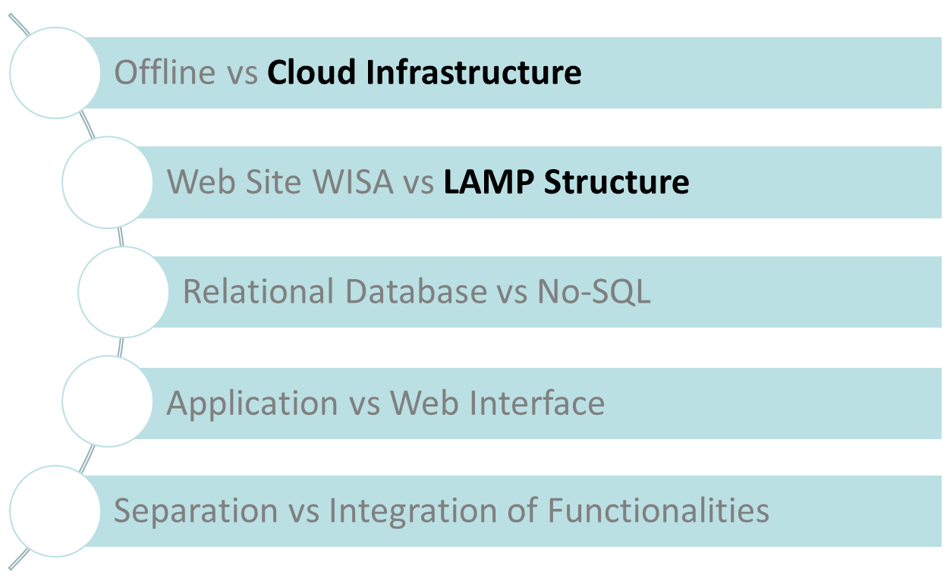
Technology
Situation Objective Envisioning Solution Solution Advantages Technology Budget/Timeline Summary

Slide 16
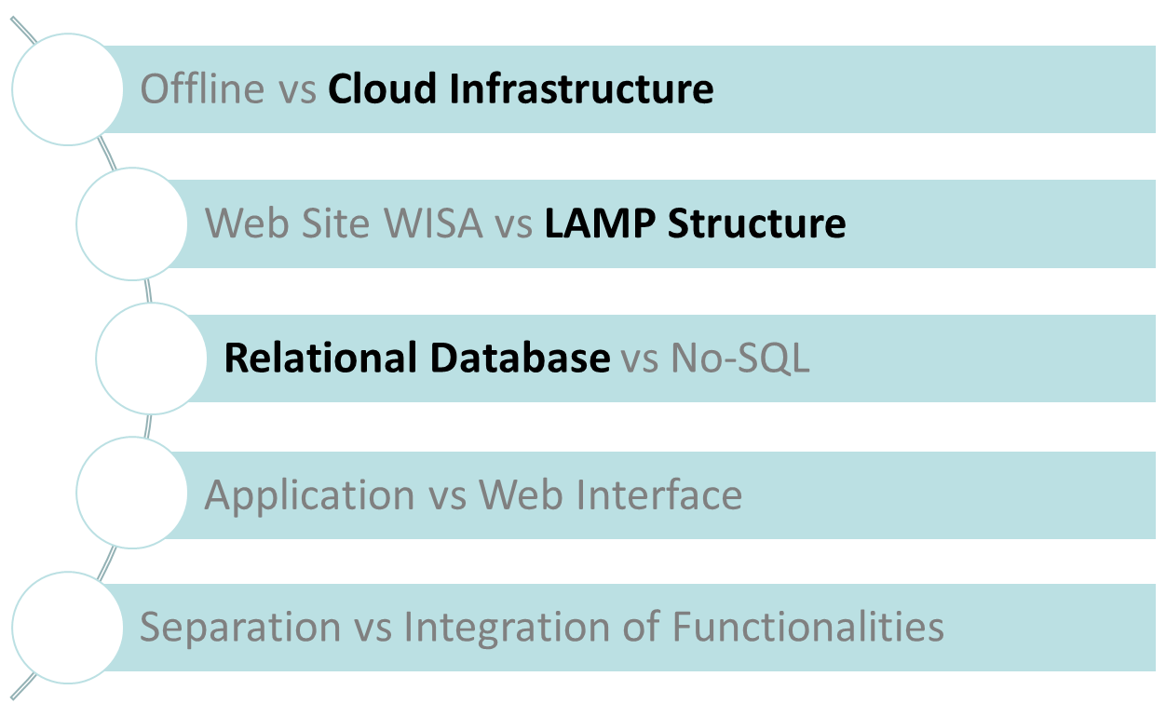
Technology
Situation Objective Envisioning Solution Solution Advantages Technology Budget/Timeline Summary

Slide 17
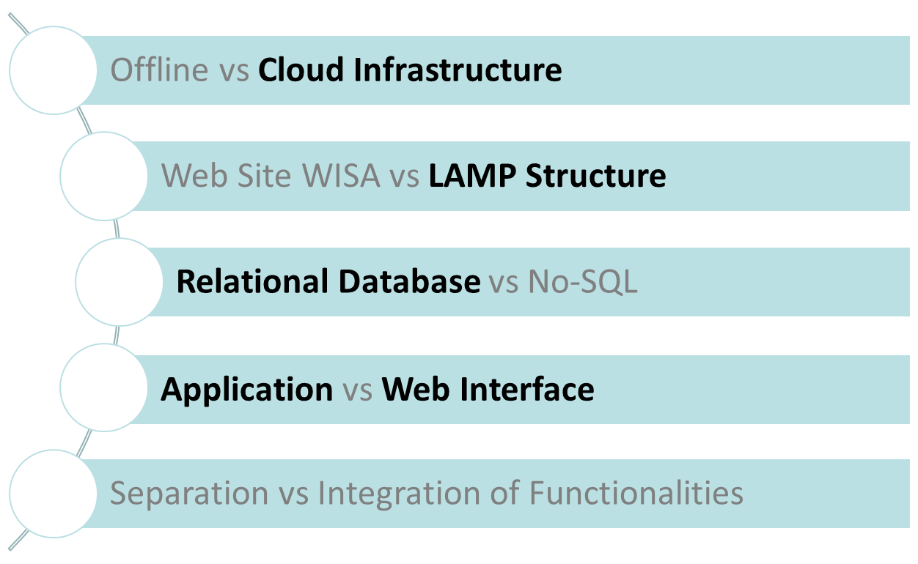
Technology
Situation Objective Envisioning Solution Solution Advantages Technology Budget/Timeline Summary

Slide 18
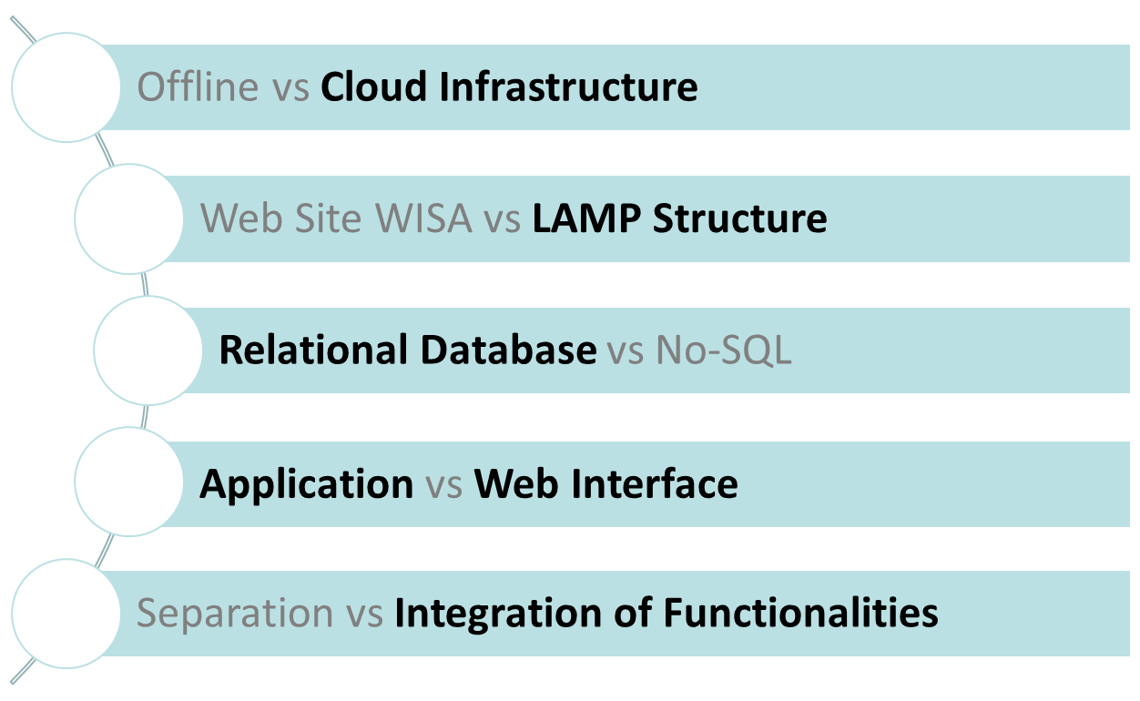
Technology
Situation Objective Envisioning Solution Solution Advantages Technology Budget/Timeline Summary

Slide 19
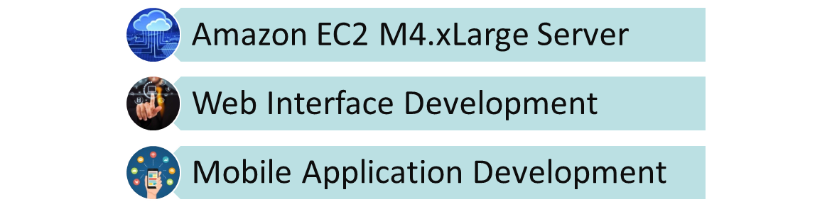
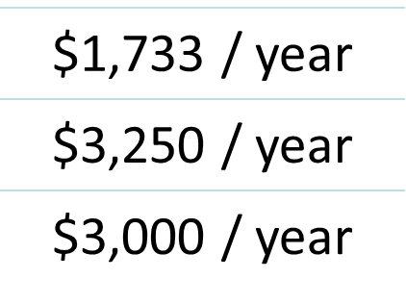
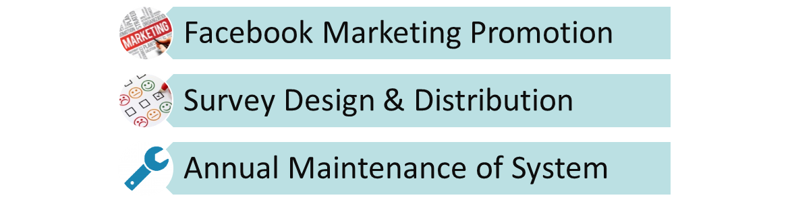
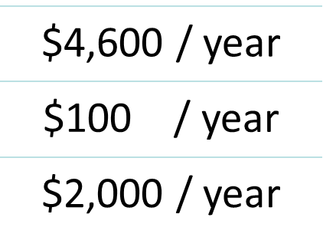
Budget
Total Ongoing Project Cost per Year: $14,683
Situation Objective Envisioning Solution Solution Advantages Technology Budget/Timeline Summary
Notes:
http://onthetech.com/despite-tight-budgets-cloud-tech-still-on-the-rise
http://www.crispen.org/src/
http://www.legalproductivity.com/legal-marketing/law-firm-marketing-tools/
https://www.mobiprobe.com/
http://blog.westmonroepartners.com/10-ways-to-improve-your-next-cx-survey/
https://www.uspto.gov/patents-getting-started/using-legal-services/pro-bono/patent-pro-bono-program

Slide 20


Timeline
Coding and Testing For Site
Initial Internal Meeting
1/2/2017
3/6/2017
Site Design
Page Artwork
Launch
1/9/2017
2/6/2017
4/3/2017
2017
Week 1
4
7
10
13
16
19
22
25
2017
Coding and Testing For App
5/1/2017
Launch
Application Function Redesign-Participation System Design
6/19/2017
4/10/2017
Meeting
1/2/2017 - 1/6/2017
Website
1/9/2017 - 4/7/2017
Application
4/10/2017 - 6/30/2017
Situation Objective Envisioning Solution Solution Advantages Technology Budget/Timeline Summary

Slide 21
Summary
Expected outcomes:
Increase participation of target age group in decision process
Enhance the ability to measure citizen’s engagement level
Make Marana a better town
Next Steps:
Schedule a meeting with the Town of Marana Legal team.
Further queries can be posted at abhinavsharma@email.arizona.edu
Situation Objective Envisioning Solution Solution Advantages Technology Budget/Timeline Summary

Slide 22
Things Discussed
Current Situation & Objectives
Envisioning Solution
Our solution & High Level Idea
Demo
Advantages
Marketing Analysis
Technology
Budget
Timeline of Implementation
Summary

Slide 23
Facebook Budget Calculation
Facebook per Click Ad Price: $0.2735
Town of Marana Population: 35,000
People Will Expose to the Ad: 7,000
People Will Click the Ad: 1,400
1,400 * $0.2735 * 12 = $4,594.8
Situation Objective Envisioning Solution Solution Advantages Technology Budget/Timeline Summary

Slide 24

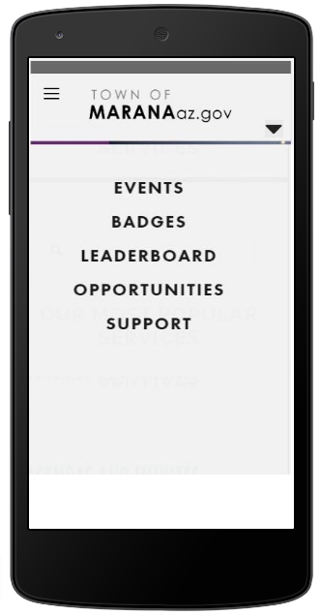
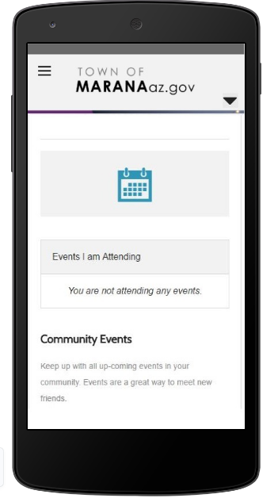
Snapshot of Marvel
Situation Objective Envisioning Solution Solution Advantages Technology Budget/Timeline Summary

Slide 25
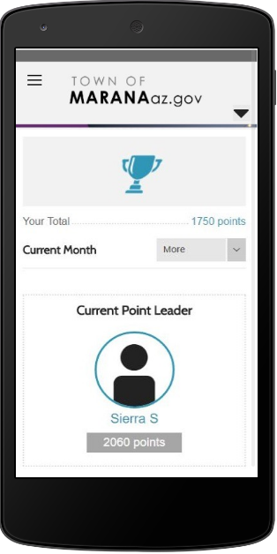
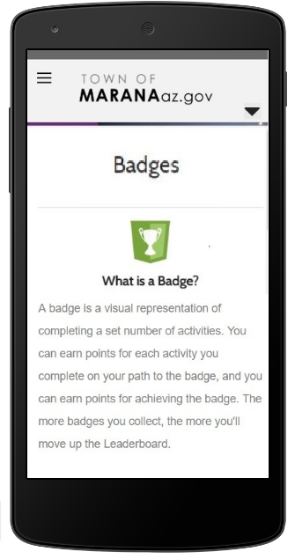
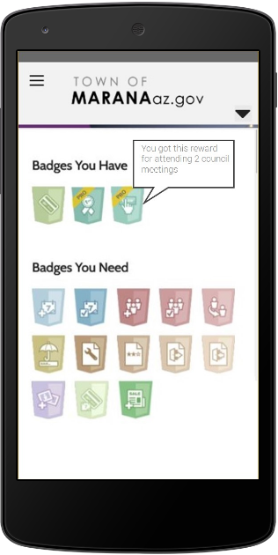
Snapshot of Marvel
Situation Objective Envisioning Solution Solution Advantages Technology Budget/Timeline Summary

